Slide 1
Unit-IV

Slide 2
Use cases for Requirement Capturing
It involves collecting and documenting the needs, desires, and expectations of stakeholders to define what a software system or product should accomplish.
5 requirements gathering techniques
There are a number of different ways you can approach requirements gathering that range in cost. Five of the most common methods are:
Interviews
Workshops
Surveys
Prototyping
Focus groups

Slide 3
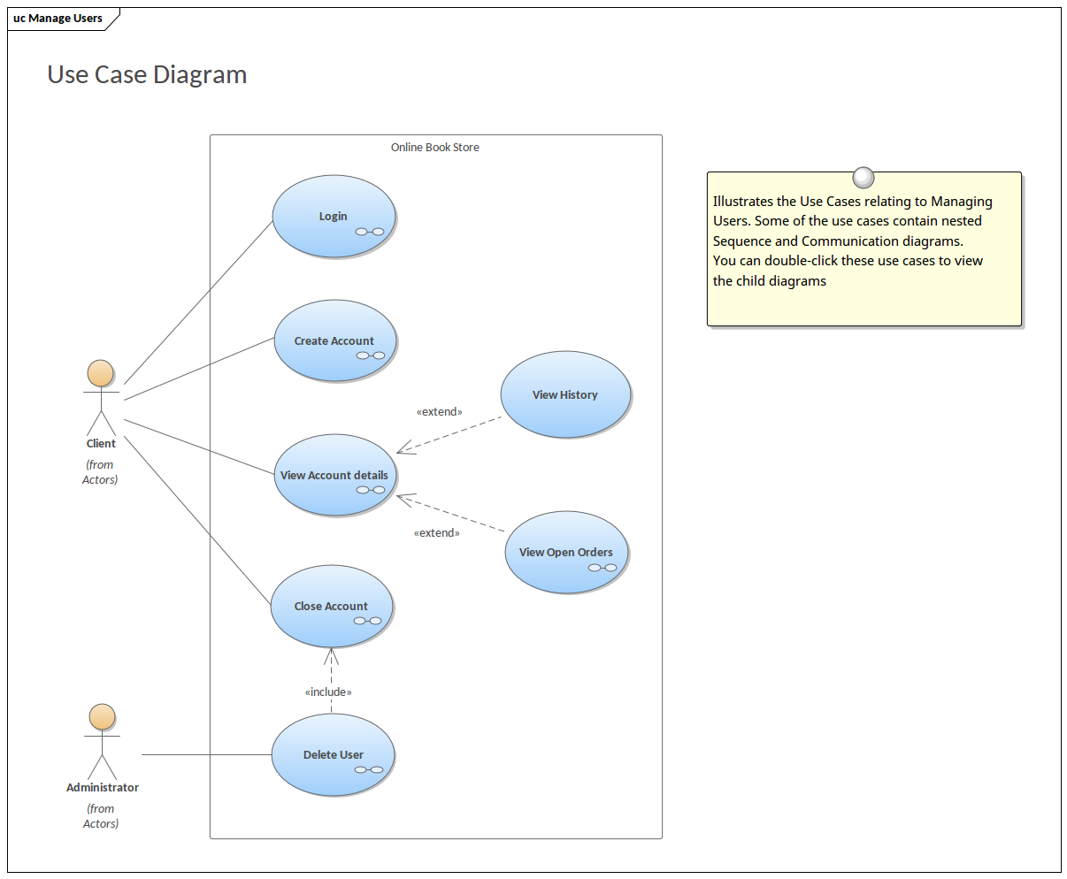
Use case Diagram

Slide 4
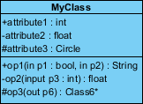
CLASS Diagram
A class notation consists of three parts:
Class Name
2. Class Attributes
3. Class Operations

Slide 5
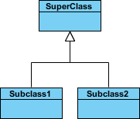
Class Relationships
Inheritance (or Generalization):
Represents an "is-a" relationship.
An abstract class name is shown in italics.
SubClass1 and SubClass2 are specializations of Super Class.
A solid line with a hollow arrowhead that point from the child to the parent class

Slide 6

Simple Association:
A structural link between two peer classes.
There is an association between Class1 and Class2
A solid line connecting two classes

Slide 7

Aggregation:
A special type of association. It represents a "part of" relationship.
Class2 is part of Class1.
Many instances (denoted by the *) of Class2 can be associated with Class1.
Objects of Class1 and Class2 have separate lifetimes.
A solid line with an unfilled diamond at the association end connected to the class of composite

Slide 8

Composition:
special type of aggregation where parts are destroyed when the whole is destroyed.
Objects of Class2 live and die with Class1.
Class2 cannot stand by itself.
A solid line with a filled diamond at the association connected to the class of composite

Slide 9

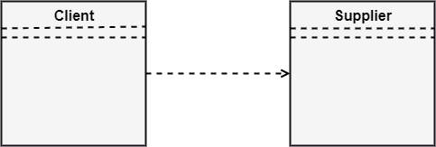
Dependency:
Exists between two classes if the changes to the definition of one may cause changes to the other (but not the other way around).
Class1 depends on Class2
A dashed line with an open arrow

Slide 10
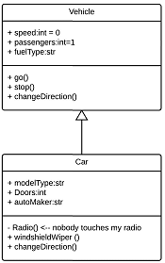

Slide 11
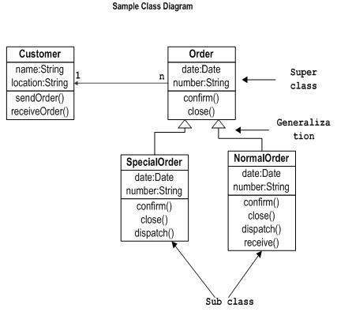

Slide 12
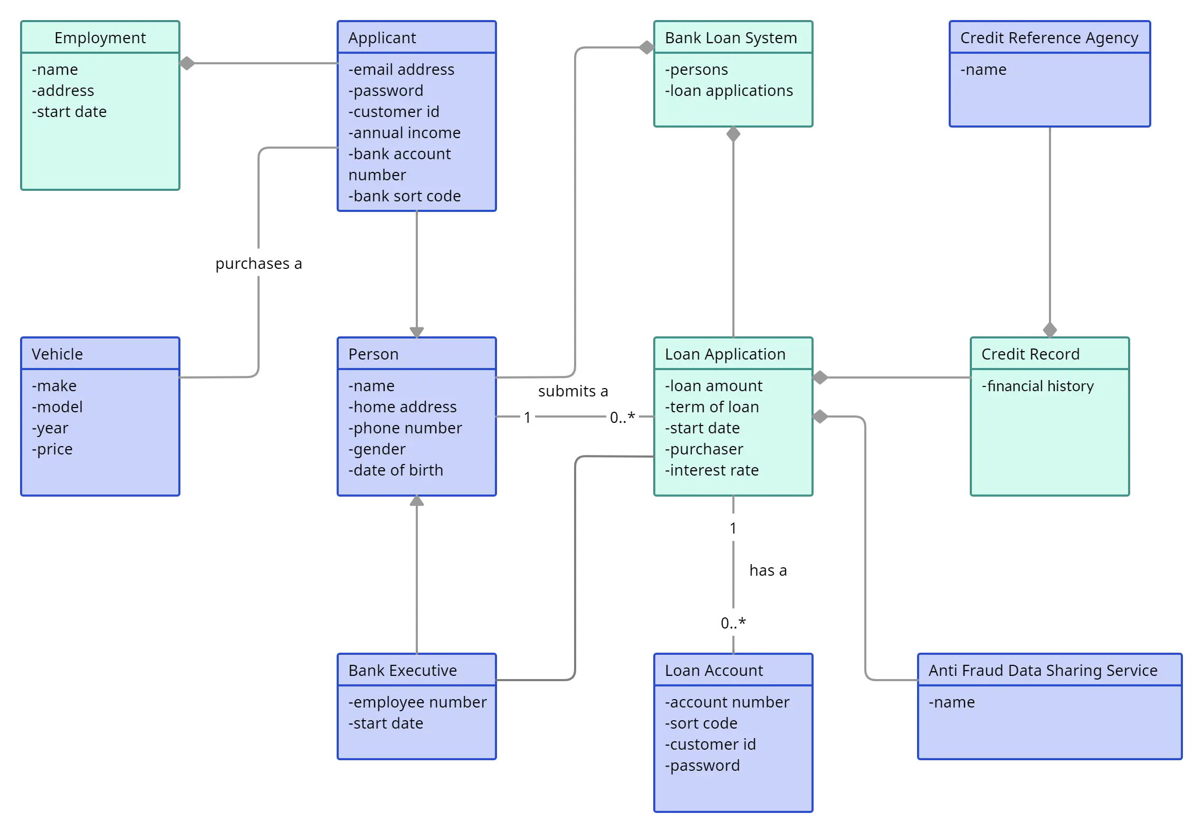

Slide 13
